Slide 2
Produce – Product overview
Cloud Apps

Slide 3
How can this document help you?
Understand the value Produce can deliver to your company
Who is Produce aimed at and what jobs can it solve
Get an overview of the solutions we have for the execution of the jobs

Slide 4
What is Produce?
A comprehensive production order backlog management that helps to manage and execute production orders by providing real-time communication to shop floor manager and operator, increasing work performance on the shop floor.

Slide 5
Who is it designed for?
Produce is aimed at manufacturing customers from discrete or process manufacturing who want to maximize their shop floor performance through effortless prioritization of production orders and direct communication to operators, without manual paper printouts.

Slide 6
Shop floor Manager
“I use Produce to organize production orders, and track work in progress in real-time.“ //John, Shop floor manager
Main jobs
manage and release production orders
prioritize production orders as rough planning
monitor production orders and track progress in real time
Pains
no real-time shop floor function available
not able to keep up with changes, completion, issues… on production orders
no real-time monitoring of production orders and visualization of the production progress
overview, prioritization, and release of production orders is too cumbersome
Gains
smart production order list
automatic prioritization of production orders for rough planning
easy real-time access to the progress of individual operation steps
production order status overview

Slide 7
Shop floor Operator
“I use Produce to start and stop operations and collect time and material requirements in an efficient way.“ Sam, Shop floor operator
Main jobs
processing of released production orders
start and stop operations
register work done and material usage
Pains
a lot of paperwork, as time and material is manually recorded on printed production orders
changes to production orders are not visible as new printouts are required
missing online access to information that’s relevant to production (e.g. material and resource requirements, stock levels, production instructions
Gains
display work list for the next production period
access to material and resource requirements
start and stop operations and collect time and material requirements efficiently

Slide 8
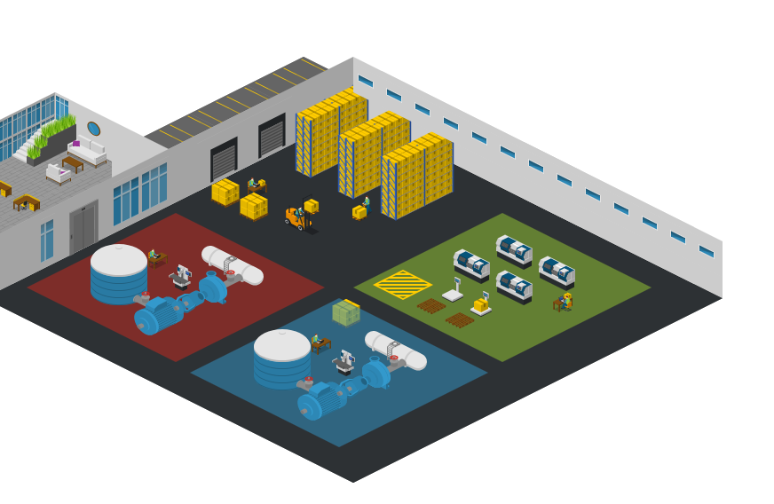
Get your work done
Shop floor managers
Shop floor manager
Organize and prioritize production orders
Provide production orders for the shop floor
Monitor production progress in real-time
Shop floor operator
Select and execute production orders
Get fast access to production relevant information
Start and stop operations and collect used time and material
Shop floor operators Area 1
Shop floor operators Area 2

Slide 9
Produce is the owner of the shop floor management and is working hand in hand with the ERP system.
ERP data & events
Produce gets new planned production orders from the ERP system as production order backlog.
Select and execute operation steps
Select the next operation steps and start the processing
Call up production information Check which materials, resources and processing information need to be used
Monitor production progress Monitor the production process and progress of individual operations or production orders
Organize and prioritize
Filter, sort and prioritize the production order backlog
Providing for shop floor operator Check material availability and release orders for the next production day
Production data collection
Record material usage and labor time, confirm finished production quantities

Slide 10
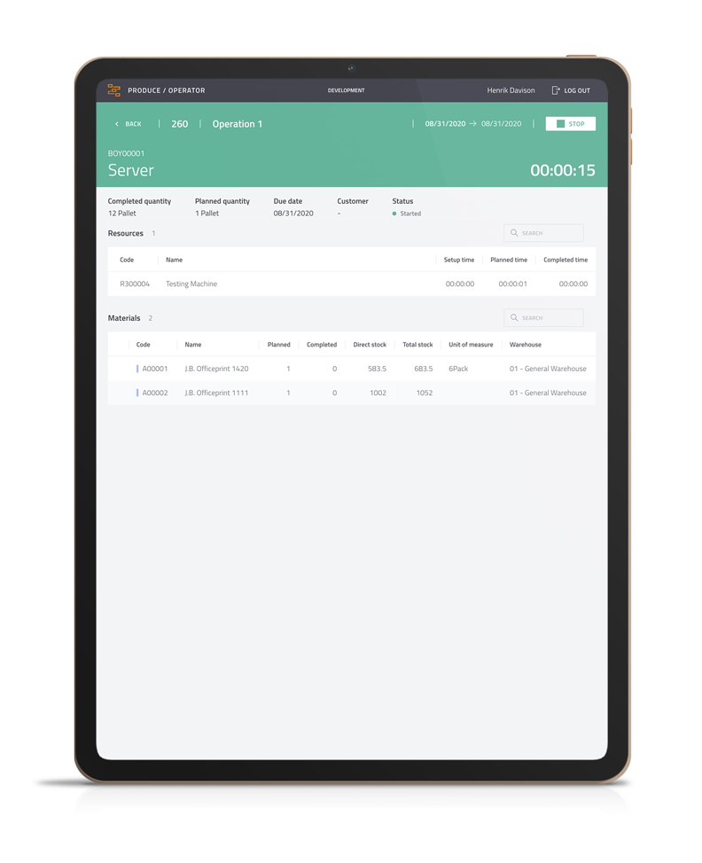
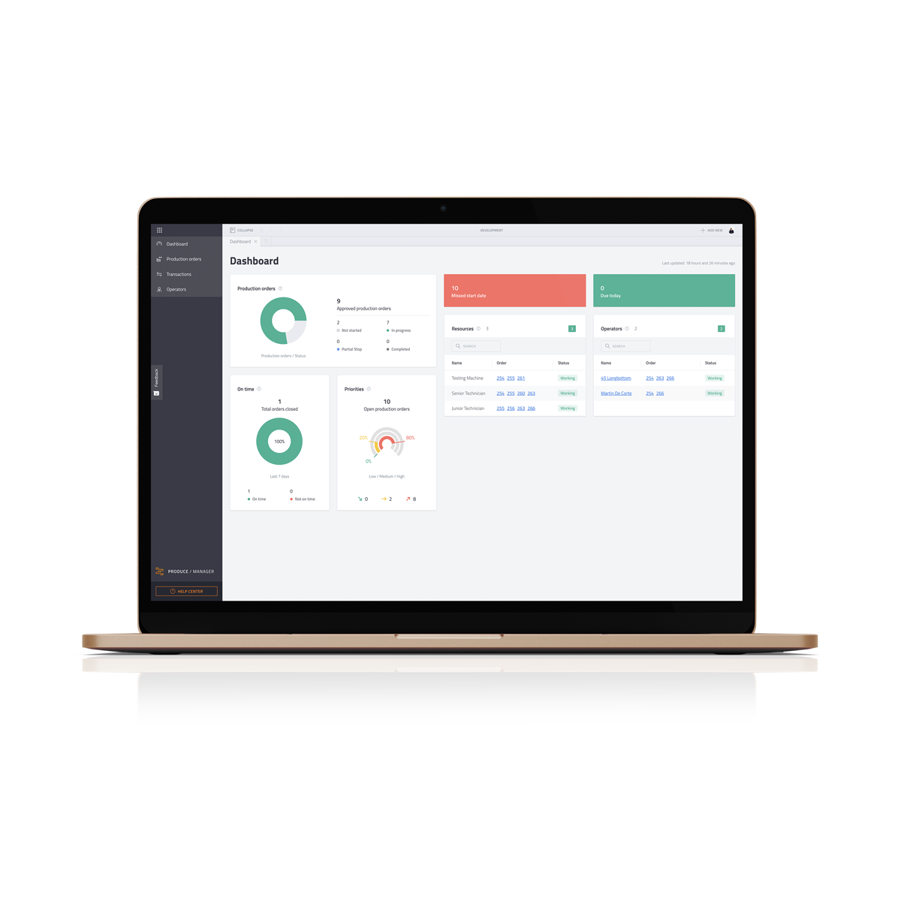
Produce is built up of 2 separate applications that work seamlessly together.
Manager
Organize production orders and track progress in real-time
Operator
View production orders and register work done and material usage​

Slide 11
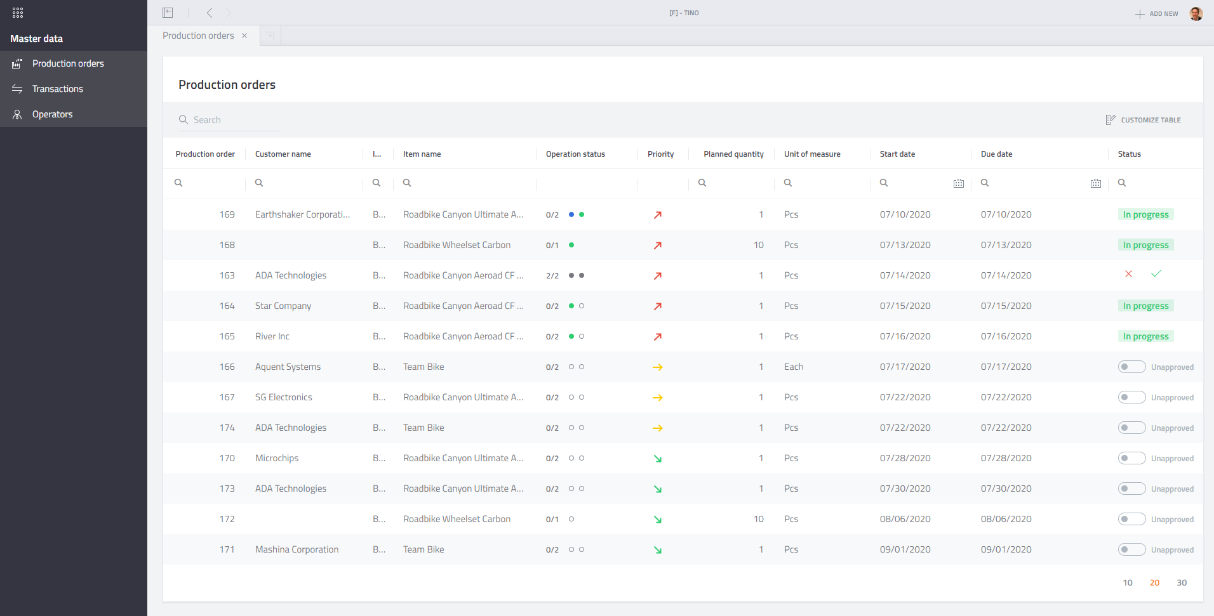
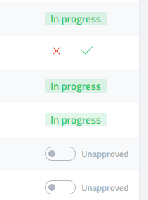
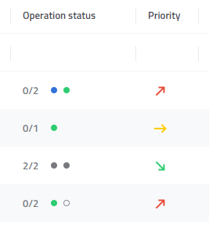
1. Organize Organize replenishment for the shop floor operators with a quick and smart overview of the production order backlog
Comprehensive production order backlog view
Production order status
Operation status
Direct execution of actions such as release and completion of production orders

Slide 12
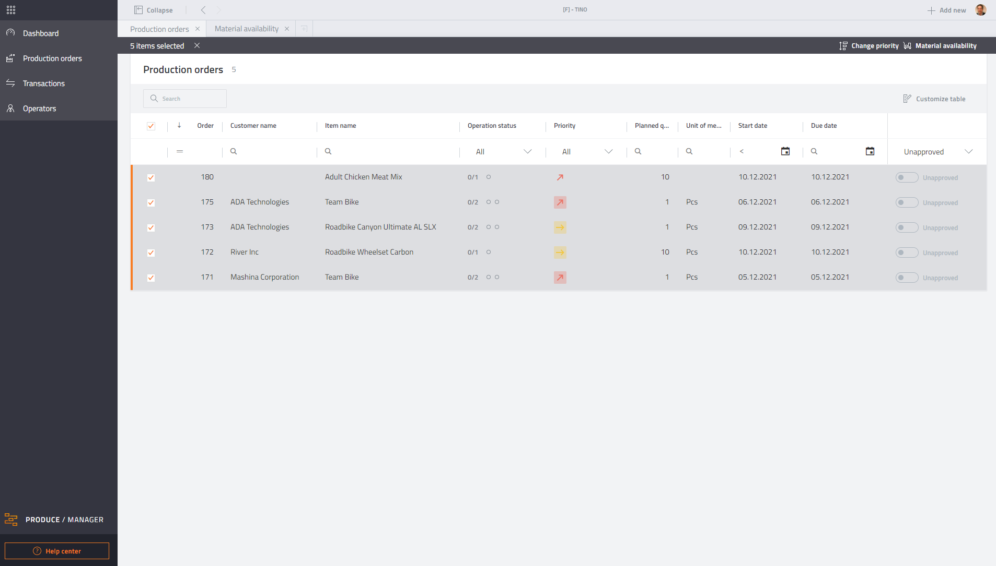
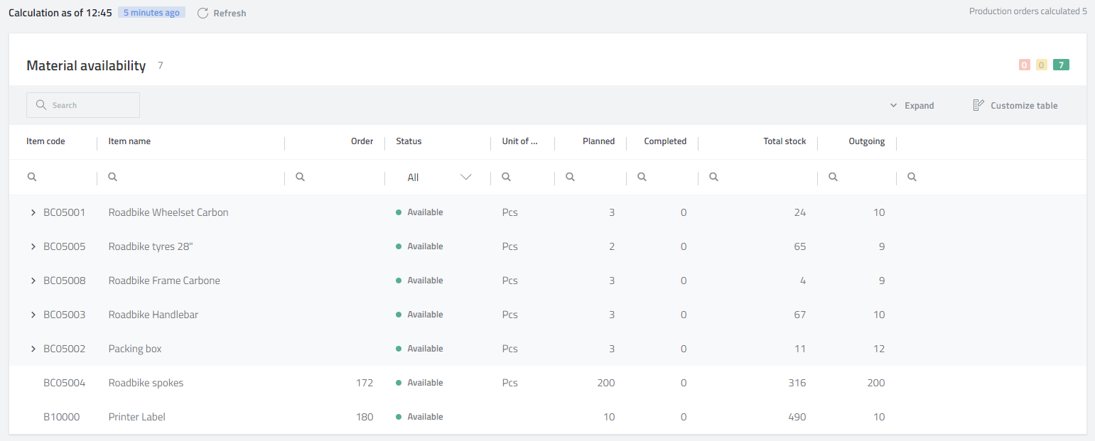
1. Organize Get help with preparation and release of production orders for the shop floor operators
Filter the high priority Production orders
Check material availability of single or multiple production orders
Simple selection of the next production orders and release stock of work for shop floor employees

Slide 13
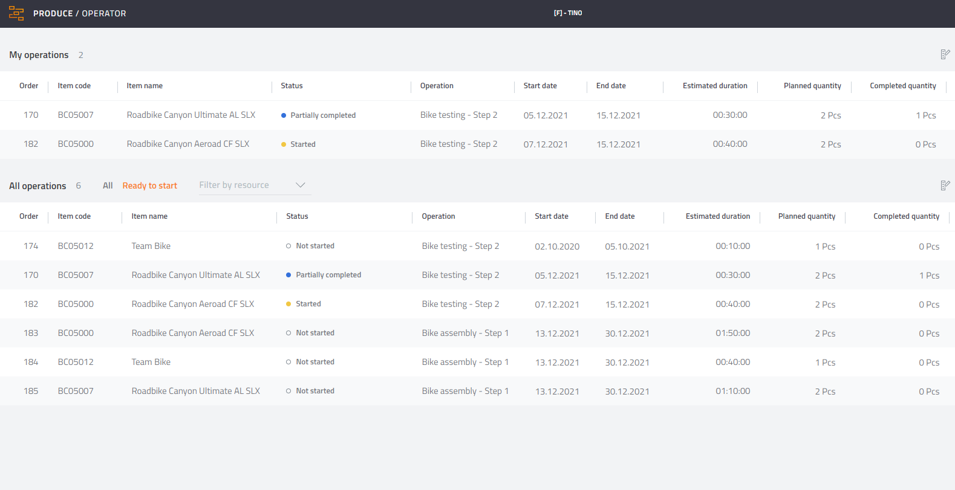
2. Execute Keep track on the shop floor order backlog and identify the next operations
Define which operators can work on which resources and show them only the operations for which they are responsible
With my and all operations every operator gets a quick overview of already started and new operations
The ready to start option shows only operations that can be processed. Subsequent operations are only displayed when previous ones are partially completed or finished.

Slide 14
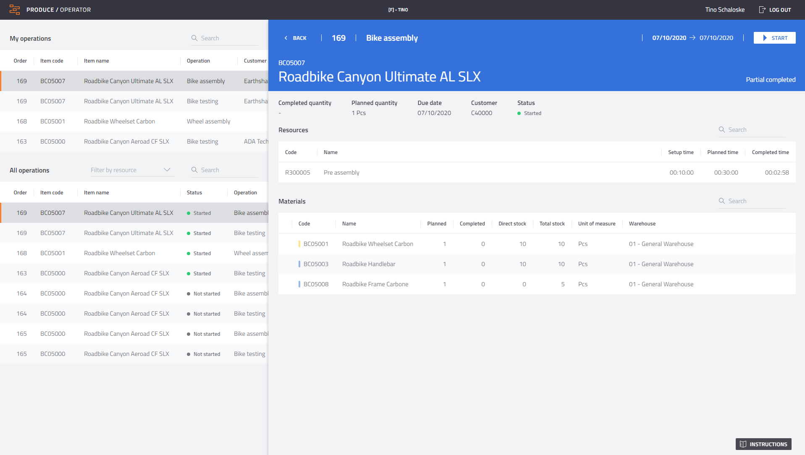
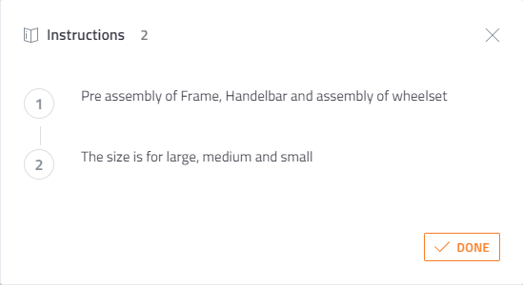
2. Execute Increase work performance by providing real-time production relevant information
Shop floor terminal supports paperless process
Display of released production order backlog
Access to material and resource requirements
Display work instructions

Slide 15
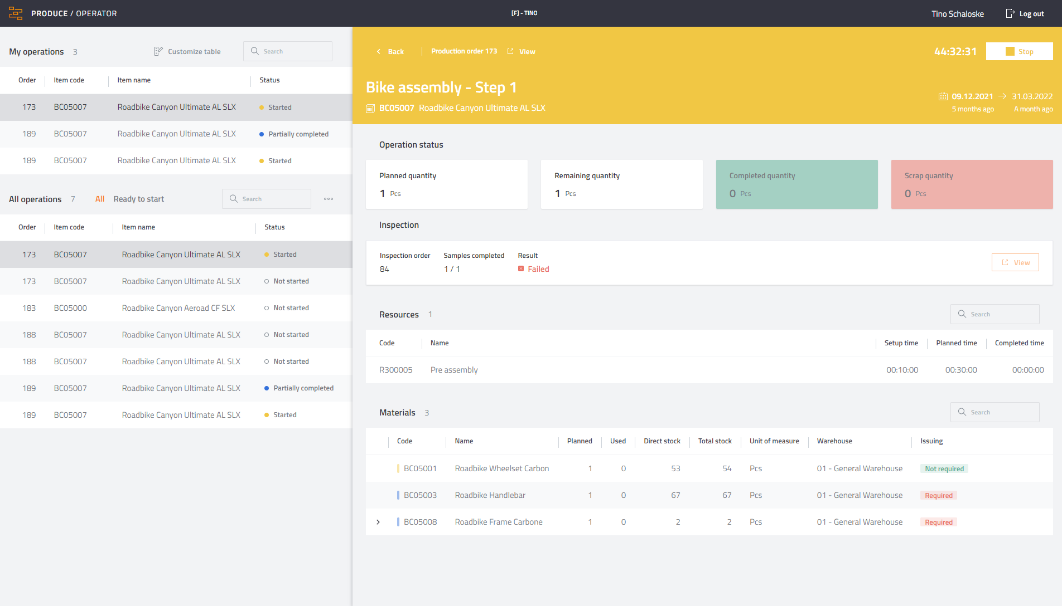
2. Execute Ensuring quality during the processing of operations
Inspect works integrated with Produce
Get information about an assigned inspection order direct in the operation detail view
Start the inspection direct via the Produce Operator terminal or alternative via Inspect
Notification of incomplete inspections
Alert for quality problems of previous operations

Slide 16
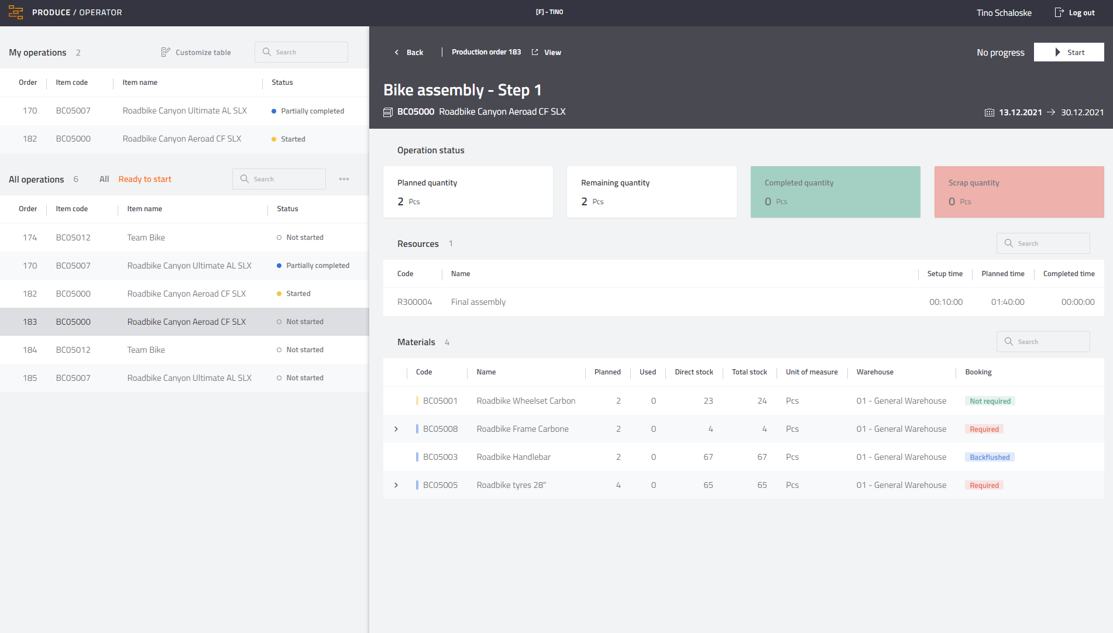
2. Execute Show the operator which materials to pick from production stock and which components to be delivered through the logistics team
Visualize the responsibility for issuing material for production
Not required: The material is issued by the logistics team
Backflushed: Material is issued automatically with the completion of the production order
Required: Material is issued via Produce with the confirmation of the operation

Slide 17
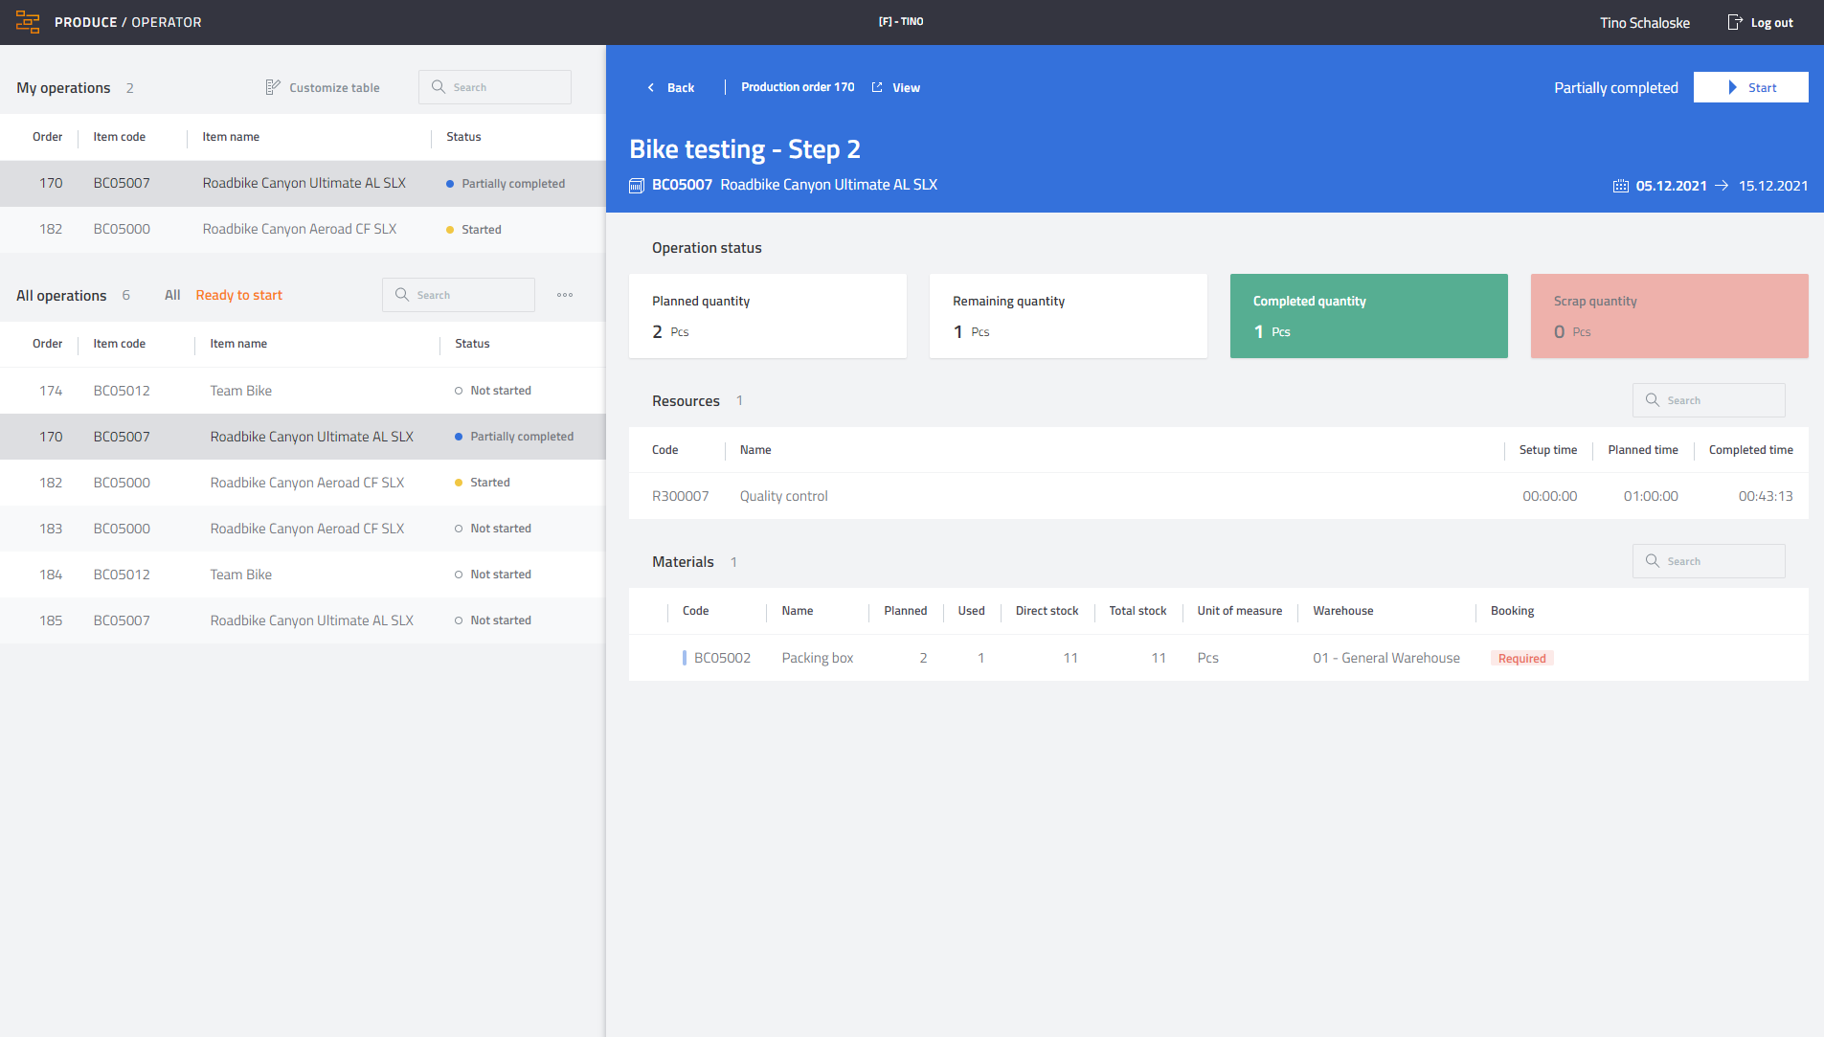
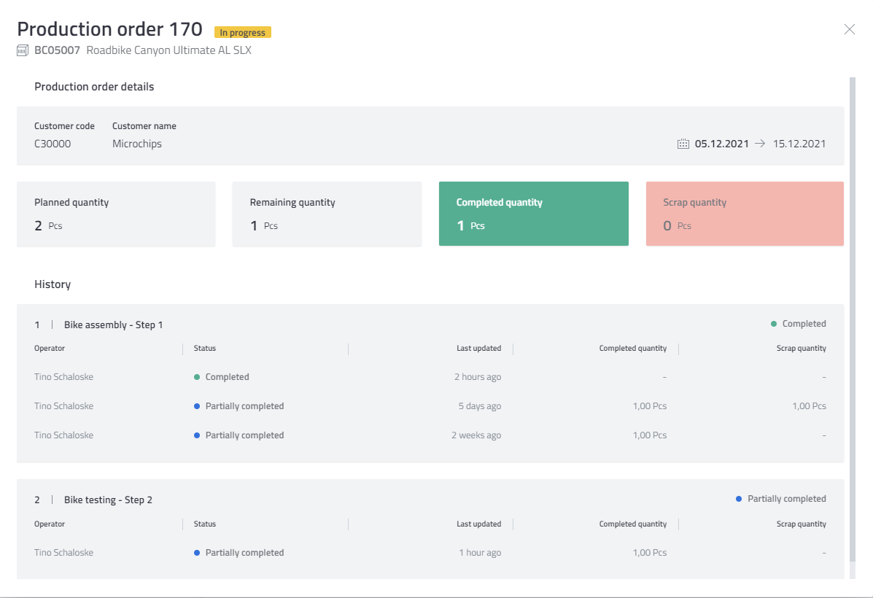
2. Execute Get more transparency and automate communication between operators
Provide operators a smart overview of the entire production order
Support the collaborative processing of operations in production teams
Keep track which employees are also working on the same operation or production orders

Slide 18
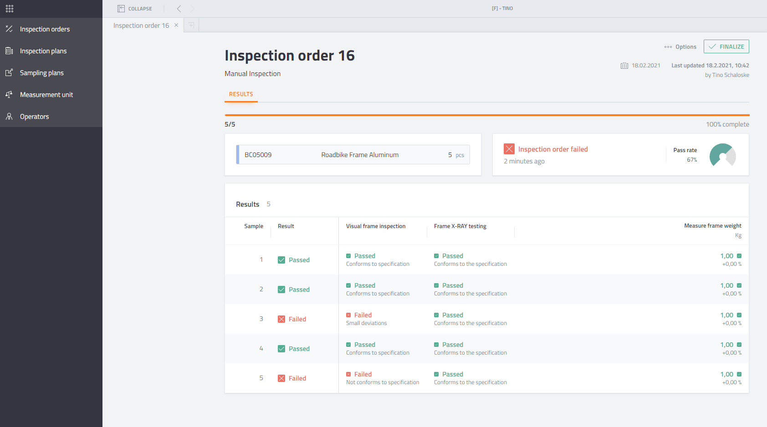
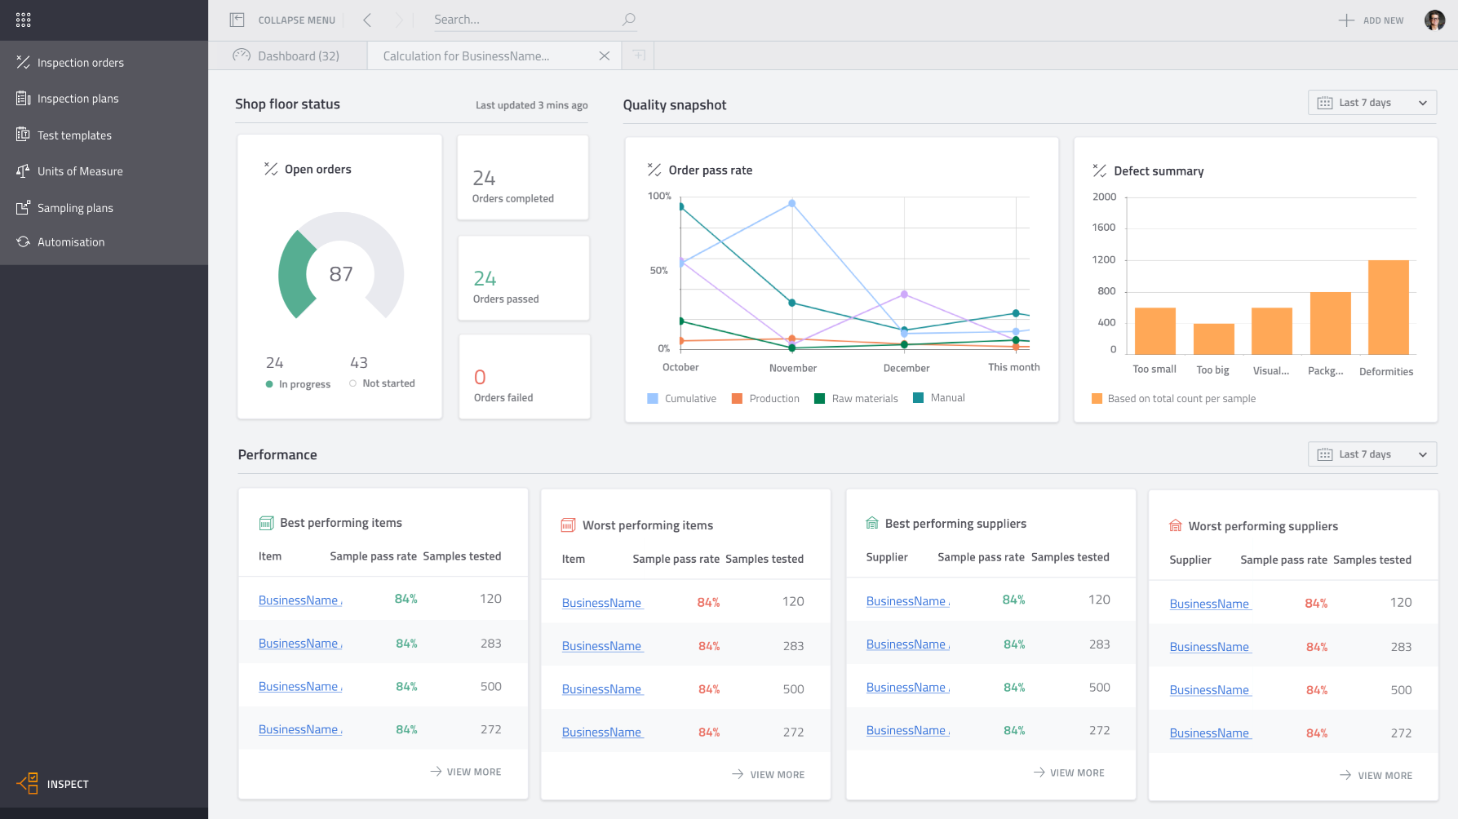
3. PDC Provide the Shop floor operators with a simple and smart user interface to collect production data
Start and stop operations
Register work done and material usage
Proposal of material issue for production considering FIFO and expiration date of batches
Confirm finished production quantities

Slide 19
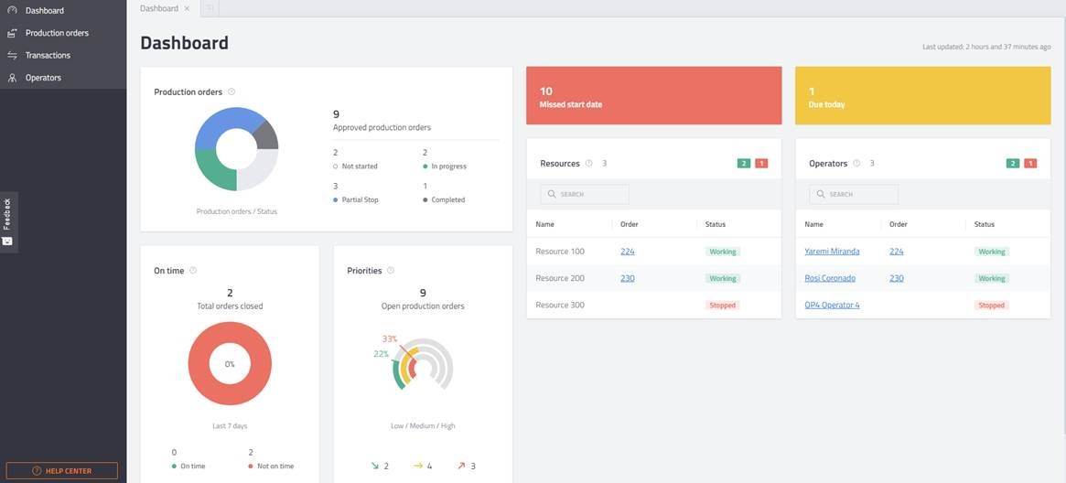
4. Monitor Identify critical situations to avoid delays by keeping an overview and the connection to the shop floor
Visualize your shop floor on a daily dashboard
Monitor the shop floor activities
Track production progress in real-time

Slide 20
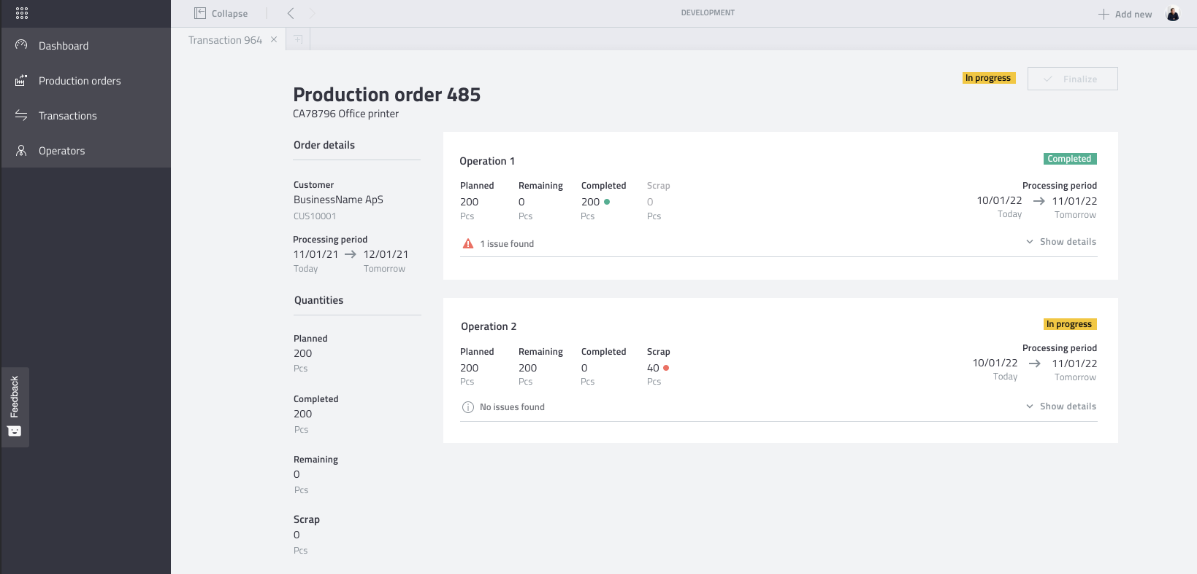
4. Monitor Keep track of planned and actual expenses.
Production order detail view to analyze issues during production
Detailed order and operation status
Planned vs. actual materials and times
Work history

Slide 21
Denmark Boyum IT Solutions A/S
Germany Boyum IT Solutions GmbH
USA Boyum IT Solutions Ins.
Belgium Boyum IT Solutions bv
Spain Boyum IT Solutions S.L.
Hungary Boyum IT Development Center

Slide 22
Get your 20-day free trial
Contact us!

